Slide 1

Australian spirituality and wellbeing
2020 Australian Community Survey
Run by NCLS Research
Dr Ruth Powell Director
NCLS Research

Slide 2


About Australian Community Surveys
Run by NCLS Research
NCLS Research aims to provide a picture of social attitudes, religion, spirituality, and wellbeing in Australian communities.
The ACS has been run by NCLS Research and partners in 1998, 2002, 2009, 2016, 2018, 2019 and 2020.
Goals
1. To compare the attitudes of church attenders and the wider community on a range of social issues;
2. To track religiosity trends over time, including religious beliefs, practices and experience;
3. To evaluate how the Australian community views the role of churches in society.

Slide 3
2020 Australian Community Survey
Two reports
This first report from the 2020 ACS provides:
1. A religious and spiritual profile of Australians,
2. Australian wellbeing, stress and support
3. Links between spirituality and wellbeing
A second report covers church engagement in the community

Slide 4
Methodology
The Australian Community Survey is an online survey.
Sample drawn from large online research panel of Australians.
Survey distributed by Online Research Unit (ORU) who meets ISO 20252 and ISO 26362 standards for both market research and panel work.
The Australian sample of around 1,300 persons is representative of the adult population on age, gender and location.
Dataset weighted to reflect the demographic profile of the Australian population aged 18+ on age, gender and education, (according to the 2016 Census).

Slide 5
Part 1: A religious and spiritual profile of Australians

Slide 6


Religious affiliation
2020 ACS
More than half of young adults have no religious affiliation
2016 Census: Around half of all Australians aged 18+ identified as Christian (53%, including 22% Catholic). 29% chose ‘no religion’.

Slide 7
Religious belief
Half believe in God, or a higher power.
Around a quarter don’t know.
A quarter do not believe
NB. A quarter of those with no religious affiliation believe in God or a life force and a quarter are unsure.

Slide 8
Religious belief and age

Slide 9

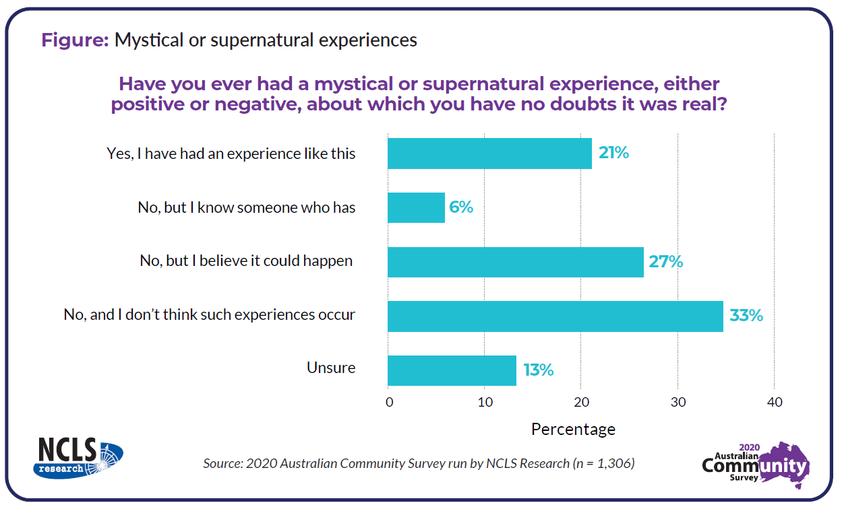
Mystical and supernatural experiences
Around half of Australians have had such an experience, know someone who had, or believe it possible.

Slide 10
Mystical & supernatural experiences by age

Slide 11

Prayer and meditation
Many Australians pray or meditate.
28% do so at least once a week.

Slide 12
Prayer and meditation by age

Slide 13

Religious service attendance
16% of Australians attended religious services weekly or monthly during 2020

Slide 14
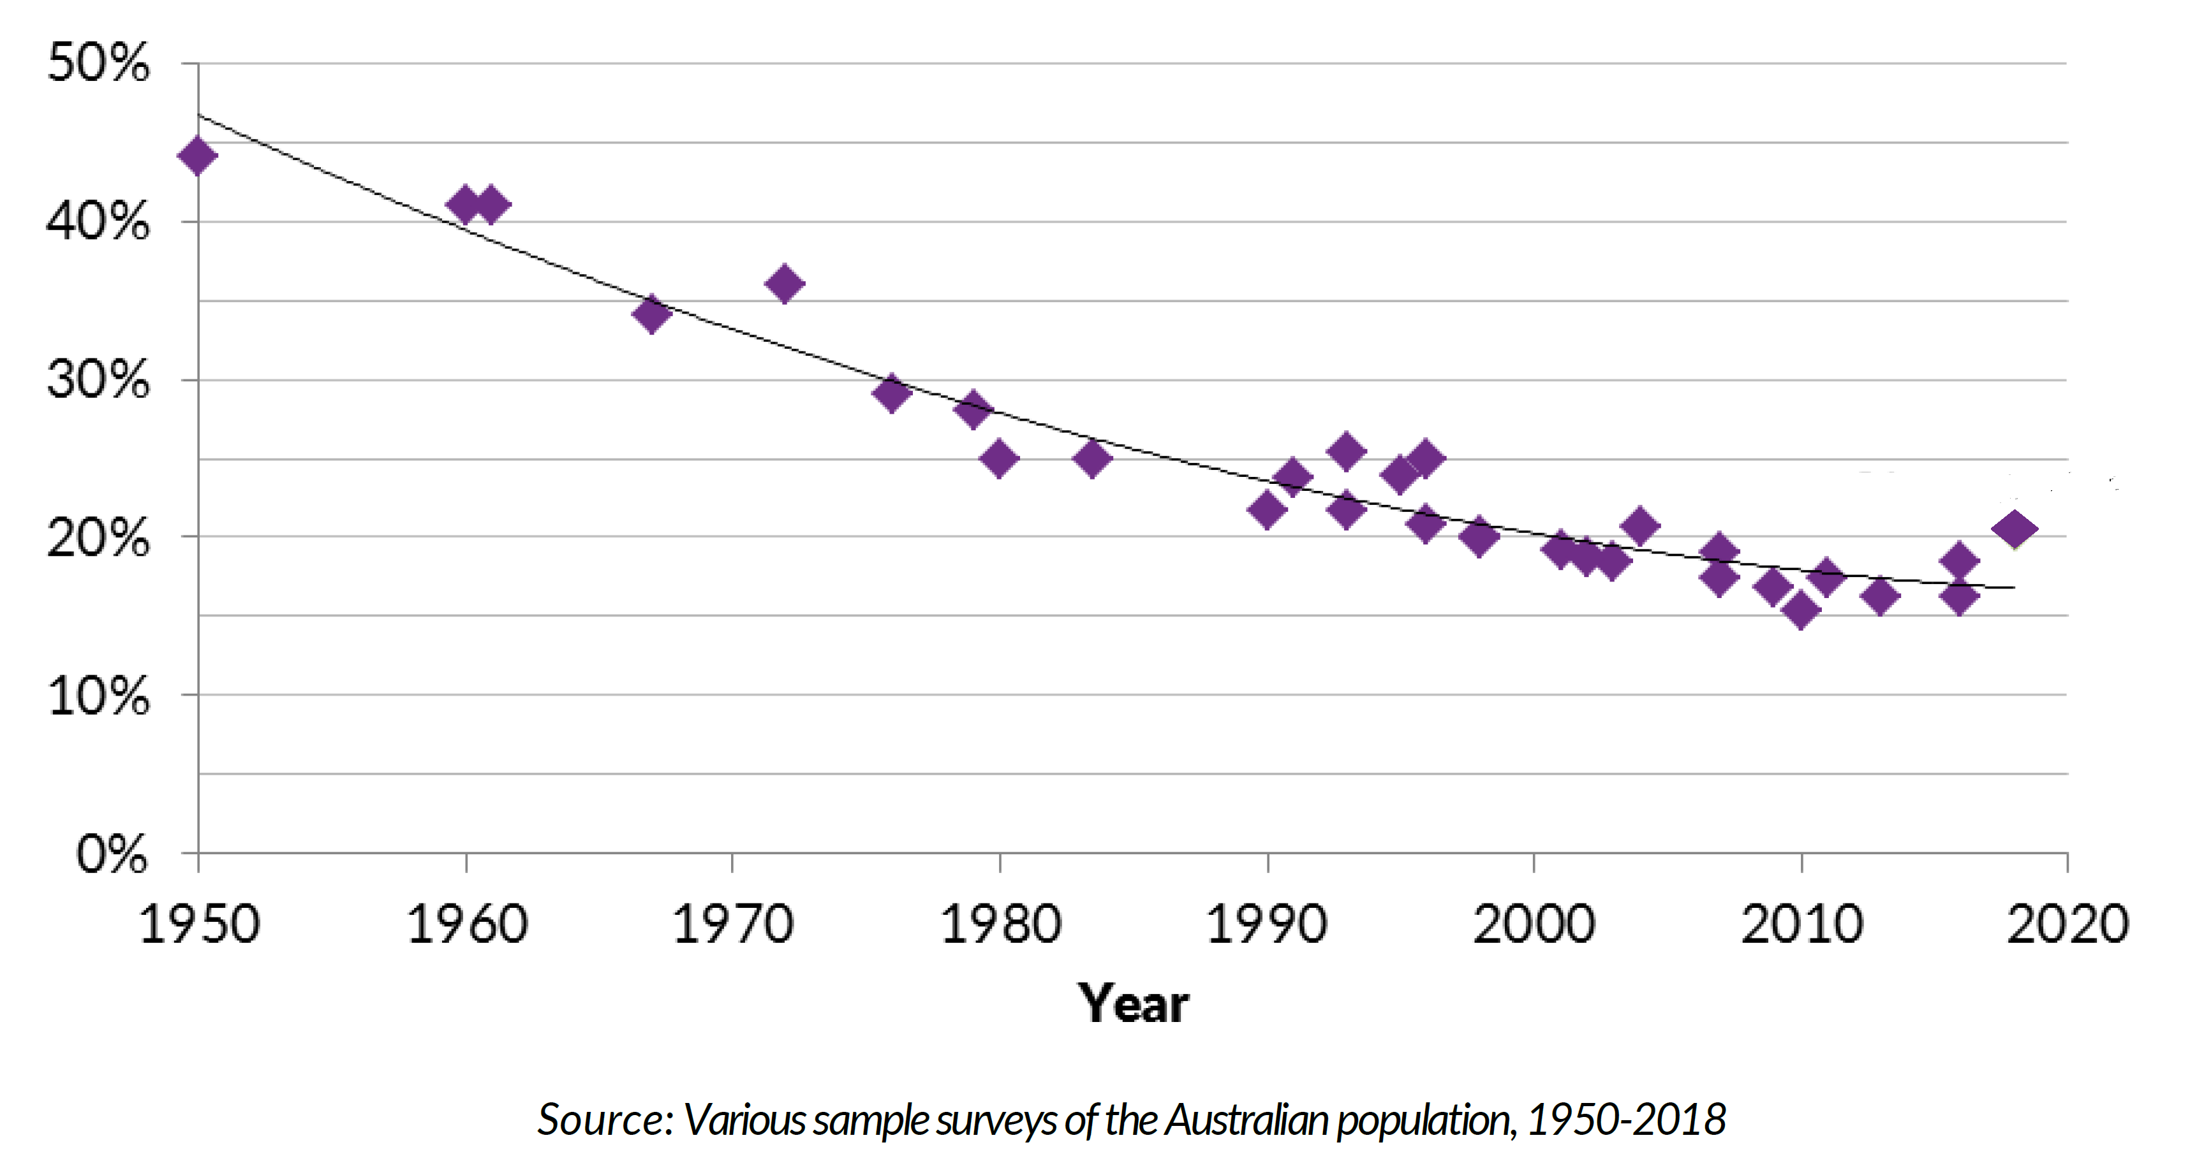
Religious service attendance over time
Figure: Self-reported monthly religious service attendance since 1950

Slide 15
Religious service attendance by age

Slide 16
Online religious service attendance in 2020
During COVID-19, religious service attendance changed as people gathered in online forums.
The 2020 ACS asked “Since March have you attended online religious services?”
No – 80%
Yes – 17%
Weddings, funerals and baptisms online - 3%
Age differences
~ 19% of each age group had tried online religious services, except those aged 50 to 64 years (only 9% went online).

Slide 17

Importance of faith for life decisions
36% of Australians say religious faith or spirituality is important in shaping life decisions.

Slide 18
Importance of faith for decisions by age

Slide 19
Self perceptions. Religious? Spiritual?

Slide 20
Four clusters of Australians
‘Religious and Spiritual’
- people who are practising
2. ‘Moderately religious and spiritual’ – non-practising
3. ‘Spiritual but not religious’, and
4. ‘Neither religious nor spiritual’.
*Based on cluster analysis and indicative of four general approaches to religion and spirituality in Australia.

Slide 21
Part 2: Australian wellbeing, stress and support

Slide 22
Satisfaction with life
Thinking about your own life and personal circumstances, how satisfied are you with your life as a whole?
Figure: Life satisfaction by age group
Australians are generally satisfied with life
86% scored 5 or higher out of 10
overall

Slide 23
Levels of stress by age
On a scale of 0 to 10, how stressed have you felt in the past month?
Figure: Levels of stress by age group
Half of Australians are moderately stressed.
Older people were generally less stressed

Slide 24
Sources of stress for Australians
Thinking about the past month (Oct-Nov 2020), have any of the following caused high levels of stress for you or your household?
Family relationships | 22%
Impact of isolation and social distancing | 22%
Safety of self, close family members or friends, due to COVID-19 | 21%
Possible or actual loss of household income | 19%
Being able to access basic needs and services | 8%
Children's education | 7%
Other | 10%
None of the above | 38%

Slide 25
Sources of support for Australians
Do you have someone you can call on for help or support?
Most Australians had someone to call on for support.
Figure: Sources of support

Slide 26
Part 3: Links between spirituality and wellbeing

Slide 27
Spiritual practices in context of crisis
In the context of this year's crises (including bushfires and the global COVID-19 pandemic), how important do you think spiritual practices are to support people's wellbeing?
Figure 16: Perceived importance of spiritual practices for wellbeing
Two-thirds thought spiritual practices have been important during the bushfires and COVID crises.

Slide 28
Spiritual practices that appeal
Whether or not you have used them, which, if any, of these spiritual practices appeal to you?
Table: Spiritual practices that appeal
Spending time in nature or outdoors | 57%
Listening to music that moves me or lifts my spirits | 47%
Prayer, meditation or mindfulness practices | 32%
Attending religious services (or services of worship) | 16%
Religious or spiritual reading | 13%
Watching or listening to religious/spiritual talks, clips, podcasts etc | 10%
Attending small groups for spiritual or social support | 9%
Other spiritual practice (please specify) | 2%
None of the above | 23%

Slide 29
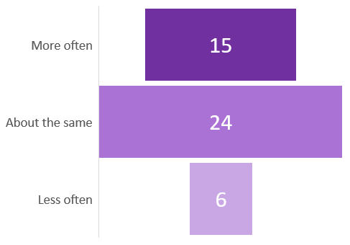
Spiritual practices in 2020 vs 2019
In 2020, have you personally drawn on any spiritual practices? If so, have you done this more often, less often or the same as in 2019?
Figure: Drew on spiritual practices in 2020
Figure : More or less than 2019

Slide 30
Invitations to church
Would Australians go to church if invited by close friends and family? (Nov 2020)
Figure: Would you go to church, if invited by family or friends?
37% say ‘yes’
15% are not sure
33% say ‘no’
37%
15%
33%

Slide 31
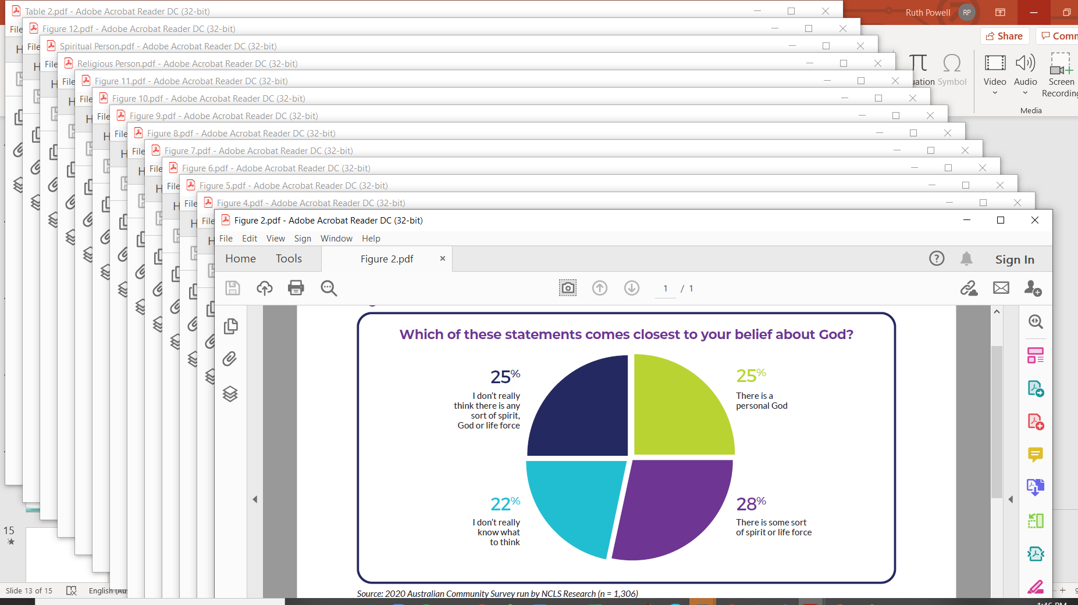
Other Resources
Full reports from 2020 ACS
Individual charts for use in other settings

Slide 32
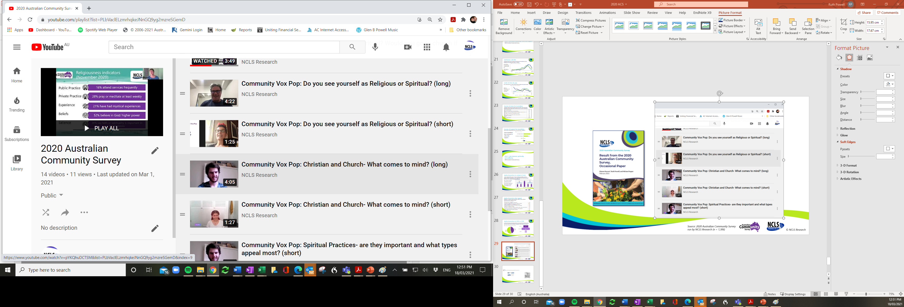
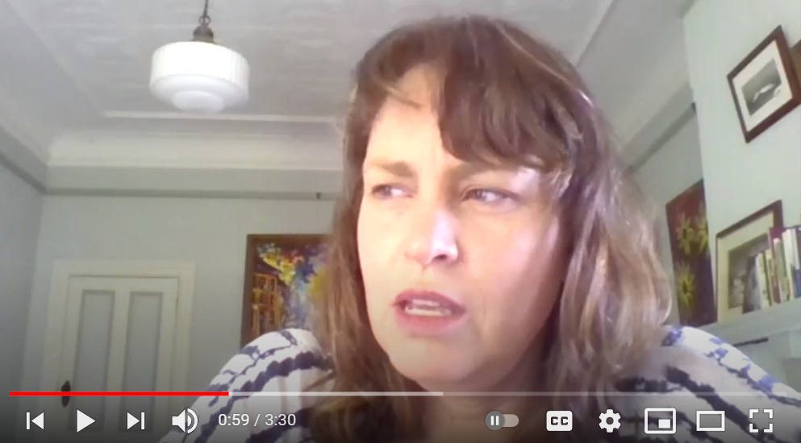
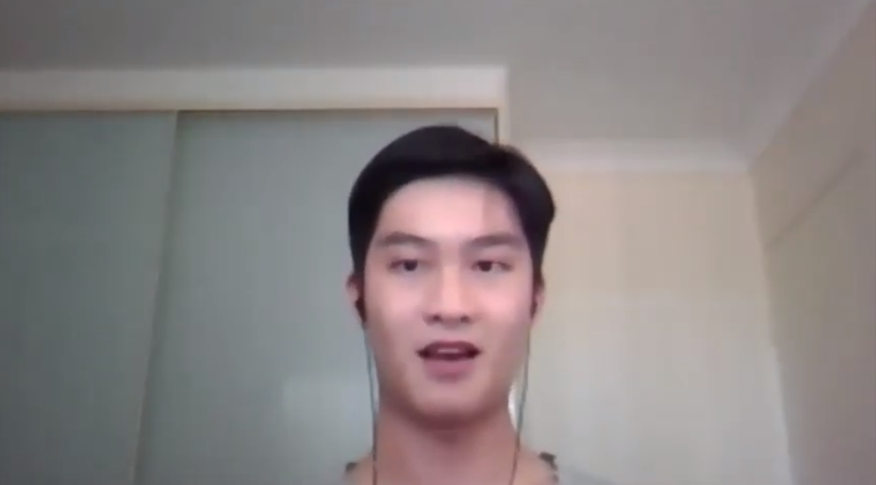
Community Vox Pop Video Resources
Simple Zoom videos with 6 Australians who do not attend church
Short format ~ 1 to 2 mins
Long format ~ 5 mins
Christian and Church- What comes to mind?
Spiritual Practices- are they important and what types appeal most?
Would you go to church if invited?
NCLS Research - 2020 Australian Community Survey playlist
https://www.youtube.com/playlist?list=PLbVaclELzmrhqkeJNnGQ9yg2mzreSGemD

Slide 33




Citation:
Powell, R. (2021). Australian spirituality and wellbeing: 2020 Australian Community Survey.
Presentation. March 2021. Sydney, Australia: NCLS Research.
Data Sources:
Powell, R., & Pepper, M. (2020). 2020 Australian Community Survey. [Data file]. Sydney, Australia: NCLS Research.
Ph: 61-2-9139-2525
E: info@ncls.org.au
W: www.ncls.org.au
@NCLSResearch
2021ncls.org.au
NCLS Research

