Slide 1
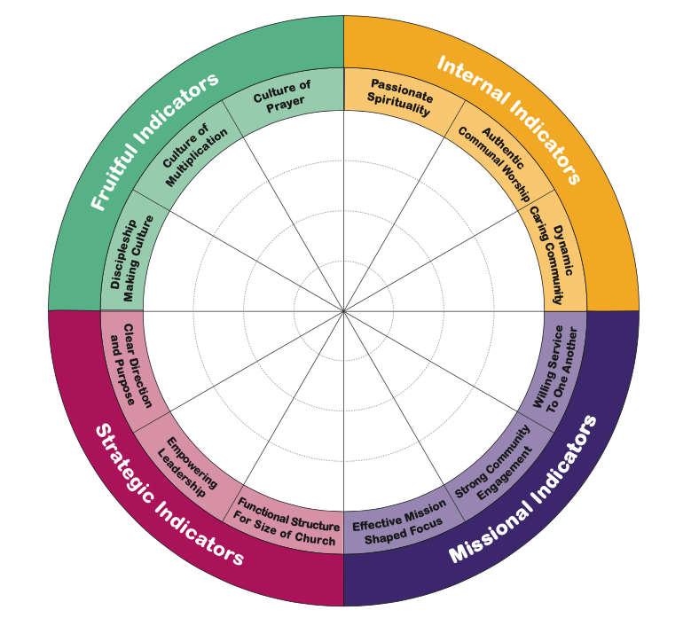
Church health Indicators
Internal Indicators
Passionate Spirituality
Authentic Worship
Caring Community
Missional Indicators
Mission Focus
Community Engagement
Serve one another
Strategic Indicators
Clear Direction
Empowering Leadership
Right Structures
Fruitful Indicators
Discipleship Making
Multiplication
Prayer

Slide 2
Church as a (healthy) system
Purpose
System input
Internal Process & systems
that integrate, regulate
& balance these elements
Genetic Makeup /DNA
System output
Immune system
System rest
7 elements of a healthy system

Slide 3
Church as a (healthy) system
Vision
Mission
Multiplication
God’s word
Worship
Purpose
System input
Internal Process & systems
that integrate, regulate
& balance these elements
Theology
History
Denomination
System output
Mission
Evangelism
Genetic Makeup /DNA
Structures
&
Governance
Values
Beliefs
Sabbath
Community
Immune system
System rest
7 elements of a healthy system

Slide 4
Church Health Paradigm
E + I + R = H
E (Observable) = External Indicators
I (Below the line) = Internal Indicators
R (Life Cycle) = Reality
H = Health

Slide 5
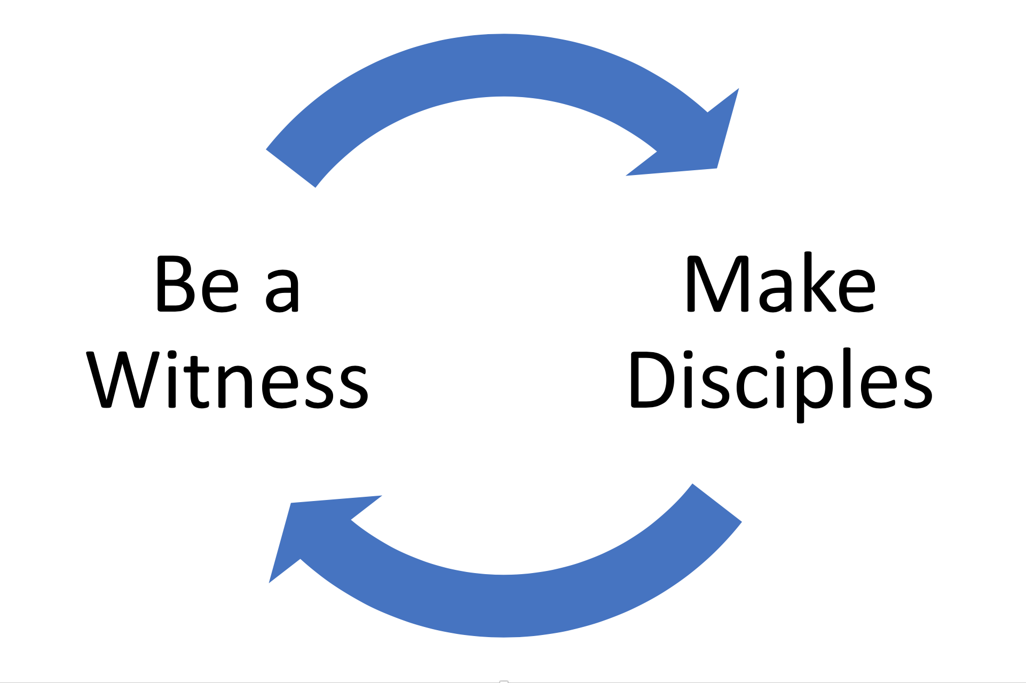
Two Things Churches Need To Be/Do
Outwardly
Inwardly
Unity
John 17
Fruitful
John 15
Act 1:8
Matt 28:19

