Slide 1
Purpose, Values & Vision

Slide 2
Introductory Exercise
You are planning a holiday for the family. You have teenage children who are on the edge of no longer coming on family holidays. You want them to come.
How do you respond to the situation?
Where will you go?

Slide 3
“Vision is a picture of the future that produces passion.”
Hybels, Courageous Leadership, 32.

Slide 4
“The vision needs to be big enough to stir the blood, specific enough to be accomplished, and short enough to be put on a bumper sticker.”,
Borden, Hitting the Bullseye, 66

Slide 5
“On the Lord’s Day I was in the Spirit, and I heard behind me a loud voice like a trumpet, which said: “Write on a scroll what you see and send it to the seven churches … Write, therefore, what you have seen, what is now, and what will take place later.”
Revelation, 1:10-11,19
“Vision is a picture of the future that produces passion.”
Hybels, Courageous Leadership, 32.

Slide 6
Is Visioning just a trendy corporate idea?
Brainstorm: Experiences of Visioning in a church context…

Slide 7
Theological Foundations
What do you think of these premises?
Is there one which particularly resonates with you?
Are there any you find particularly questionable?

Slide 8
Theological Foundations
What is the vision (the picture of the future) highlighted in the following passages?
Is it a good vision? Who’s vision is it?
Genesis 11:1-9
Matthew 13:1-52
Revelation 21

Slide 9
Theological Foundations
Any other relevant Biblical passages or principles come to mind?

Slide 10
Purpose, Values & Vision

Slide 11
Purpose, Values & Vision
      PURPOSE is why we exist

Slide 12
Purpose, Values & Vision
      PURPOSE is why we exist
                VALUES are the way we operate - the way we do
                things around here

Slide 13
Purpose, Values & Vision
      PURPOSE is why we exist
                VALUES are the way we operate - the way we do
                things around here
                VISION is our next destination - a word picture of
                what we think the future might look like
                under God

Slide 14
Purpose, Values & Vision

Slide 15
Purpose, Values & Vision
      PURPOSE is determined Biblically

Slide 16
Purpose, Values & Vision
      PURPOSE is determined Biblically
                VALUES are uncovered not created

Slide 17
Purpose, Values & Vision
      PURPOSE is determined Biblically
                VALUES are uncovered not created
                VISION is imparted by God, discovered through
                prayer, & acknowledged by the
                church body

Slide 18
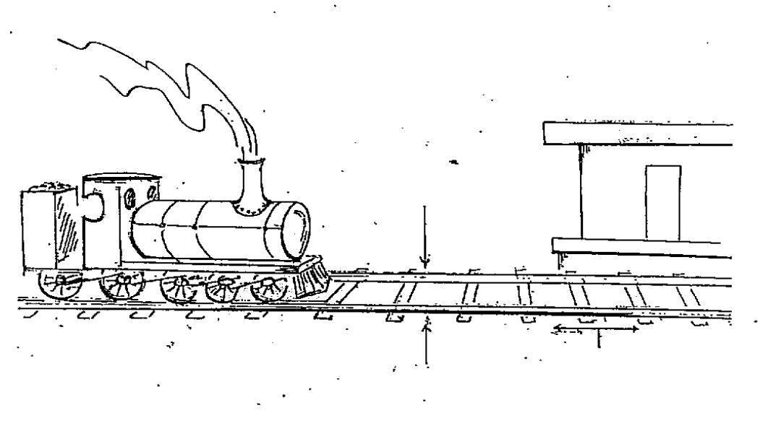
The importance of Purpose, Values & Vision
Vision
Purpose
XXX
Baptist Church
Strategic Steps
Values

Slide 19
Checking our PURPOSE Statement
Remember: Purpose is why we exist
Is our purpose statement:
Biblically based?
One sentence?
Over-arching rather than specific?
Applicable to most churches?
Timeless? ie. it will never go out of date

Slide 20
“A good mission (purpose) must be broad, comprehensive and overarching. It is the primary goal, mandate or charge that is over all other goals.”
Malphurs, Advanced Strategic Planning, 105

Slide 21
Checking our VALUES Statement
Remember: Values describe the way we operate
Are these values:
Evident in the history/life of the church?
Do they feel like they ‘fit’?
Do they evoke a ‘gut reaction’? (an emotive response)
Are they ‘realised’ or ‘aspirational’ values?

Slide 22
“The constant, passionate, biblical core beliefs that drive the ministry.”
Malphurs, Advanced Strategic Planning, 83
For reflection:
  “Values eat vision for breakfast.”

Slide 23
Checking our VISION Statement
Remember: Vision is our next destination - a word picture of what we think the future might look like (under God)
Has this vision statement:
Been given by God?
Been the subject of significant prayer in the life of the church?
Been acknowledged & affirmed by the church Body?
A future aspect? (not describing things presently)
A specific nature? (progress is measurable)

Slide 24
“A vision is a target that beckons.”
Bennis and Nanus, Leaders: The strategies for Taking Charge, 88.

Slide 25
Visioning Process

Slide 26
“One core duty that the lead pastor can never give away is the role of chief vision-caster. This premise does not mean that only a natural visionary can be the primary leader, for there are many ways to formulate the vision with the help of others; it does mean that only the primary leader can adequately champion the vision.”
Kaiser, Winning on Purpose, 110.

Slide 27
“Vision is at the very core of leadership.”
Hybels, Courageous Leadership, 31

Slide 28
Uncovering Vision
Elements that need to be understood from the outset:
Time
Participation
Listening
Wrestling
Commitment

Slide 29
Surfacing Vision - reflections
A vision created quickly in a rush of enthusiasm will normally sit quietly in the corner and lead to complacency.

Slide 30
Surfacing Vision - reflections
God has a vision for this church; he is already communicating this vision; how do we assist a church to listen, articulate this, commit to it and act upon it.

Slide 31
Surfacing Vision - reflections
God usually speaks in many and various ways in and through his people. How do we empower a congregation to discern wisely and well.

Slide 32
Surfacing Vision - reflections
Vision formation always involves spiritual formation.

Slide 33
Surfacing Vision - reflections
Surfacing a vision is work for the spirit, the heart and the mind.

Slide 34
Establishing Purpose
Could apply to any church in any place
Still value in formulating own clear statement
usually the most straightforward, but fundamentally important, nonetheless
complements a vision statement that is a more concrete picture of the ‘next destination’, looking forward for this church at this time in this place

Slide 35
Purpose Reflection
individually: read & reflect on passages - what should be included in our church purpose statement - list ideas (not about how we ‘word’ it)
small groups: share list with each other - one group member records any ideas that arise more than once amongst the group members
large group: facilitator has each small group share one point (until the list is exhausted) noting how many groups had the same answer

Slide 36
Refining a Purpose Statement

Slide 38
Uncovering Values
Uncovered not created
Evident in the history / life of the church?
Do they feel like they ‘fit’?
Do they evoke a ‘gut reaction’? (an emotive response)
Build quite slowly & change quite slowly.

Slide 39
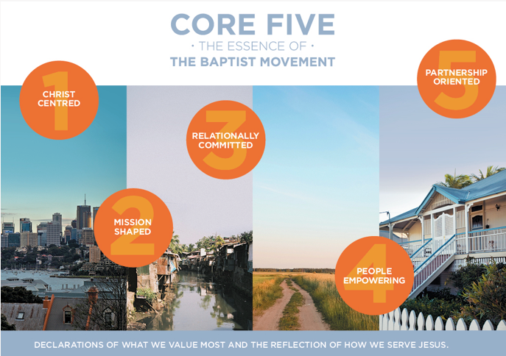

Slide 40
Values
Values answer the core question:
Why do we do what we do?

Slide 41


Slide 42
The Importance of Core Values
Why are an organization’s core values important?
Values determine a church’s ministry distinctive.
Values dictate people’s personal involvement in the church.
Values communicate what’s important.
Values help people embrace positive change.
Values affect the church’s overall behavior.
Values inspire people to action.

Slide 43
The Importance of Core Values
Why are an organization’s core values important?
Values enhance credible leadership.
Values shape a ministry’s character.
Values contribute to ministry success.

Slide 44
Defining Core Values
Core values are constant.
Core values are passionate.
Core values are biblical.
Core values are core beliefs.
Values drive the ministry.

Slide 45
Five Kinds of Values
Conscious versus unconscious values.
Shared versus unshared values.
Personal versus organizational values.
Actual versus aspirational values.
Good versus bad values.

Slide 46
Three Distinctive Features
Functions – Not Forms
Ends – Not Means to an End
The Explanation for What We Do

Slide 47
Discovering a Church’s Values
What is a good church-related memory?
What values do these memories reveal?
Other tools: list of values, storytelling…

Slide 48
Negative Values
Churches have both positive and also usually some negative values. Whilst we often don’t talk about the negative values they are still very powerful in the life of any church.
What are some things (values, attitudes, or behaviours) that might hold us back at present?

Slide 50
Surfacing Vision

Slide 51
The importance of Purpose, Values & Vision
Vision
Purpose
XXX
Baptist Church
Strategic Steps
Values

Slide 52
Checking our Vision Statement
Remember: Vision is our next destination - a word picture of what we think the future might look like (under God)
Has this vision statement:
Been given by God?
Been the subject of significant prayer in the life of the church?
Been acknowledged & affirmed by the church Body?
A future aspect? (not describing things presently)
A specific nature? (progress is measurable)

Slide 53
Why is Vision Important?
it increases energy and moves people into action
increases ownership
provides focus
smooths leadership transition
helps in decision making about ministries, structures, opportunities and alternatives
assists clearer communication about “who we are”
helps develop and maintain unity
(Hybels, Courageous Leadership, 45 – 49, for points 1-4)

Slide 54
Surfacing Vision - tools
‘…in 5 years’
‘top 5 dreams’
Vision Wall
‘Eyes Wide Open’ prayer walk
Grid of options ‘What does God want our church to look like?’

Slide 55
Strategic Planning
A Strategic Plan is simply a series of goals, and the order in which they will be undertaken, to help a church get from where it is to where it believes God would have it be.

Slide 56
A good Strategic Plan is important because without it:
a vision may seem too big and unachievable
a congregation may be diverted by things that are not relevant to the Vision
there is no substantive reference point for the evaluation of progress

Slide 57
A good Strategic Plan includes:
Strategic priorities for the period of the plan
Key objectives – what is the plan seeking to achieve?
Key enablers – people and resources
Key accountabilities – how will progress be assessed?

Slide 58
A good Strategic Plan is S.M.A.R.T.
Specific
Measurable
Achievable
Relevant to the Vision
Time Specific

Slide 59
Strategic Planning
How to make Vision a Reality
How have you done it?
How to ensure strategies flow from Vision?

Slide 60
Purpose, Values & Vision

