Slide 1

Redefining Success in Ministry –
according to Jesus
Greetings from Caringbah Baptist and
SIM Australia
Identify harmful definitions of success
Apply Jesus’ definition of success
In community

Slide 2
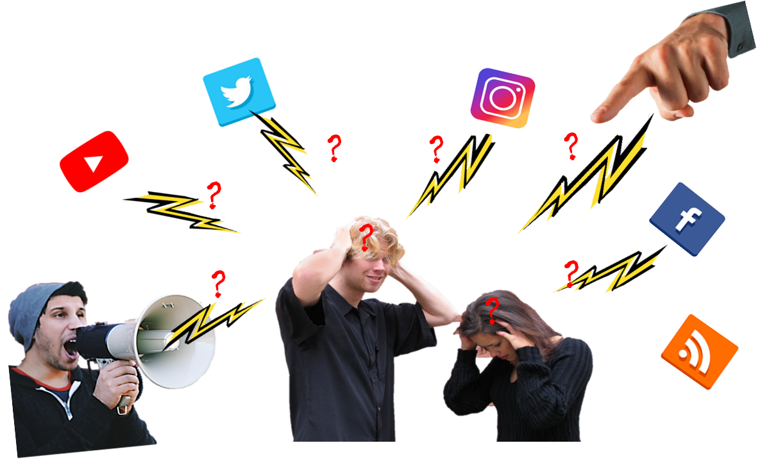
What is your experience with success in ministry?
When do you feel like a success?
or more like a failure?
Internal and External Voices

Slide 3
1. Identify harmful definitions of success
Sad – disappointment, never enough, burdened, like a failure
Mad – angry, unfair criticisms, disapproval
Bad – shame, guilt, condemnation
Possibly when you are feeling sad, mad or bad in relation to your ministry

Slide 4


We all suffer from harmful definitions of success

Slide 5
Power
Influence
Popularity
Approval
Pleasures
Possessions
Harmful Definitions
of Success
Appearance
Other
Achievements
Outward Symbols
Status
Job/Business
What definitions of success are harming you?
Type briefly in the Chat box

Slide 6
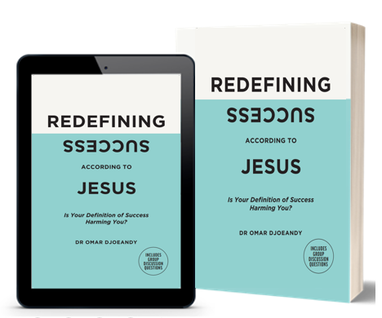
How does Jesus define Success?
Essentials:
*
*
*
*

Slide 7


2. Apply Jesus’ definition of success
“Watch out!
Be on your guard against all kinds of greed;
life does not consist in an abundance of possessions.” (NIV)
Life is not measured by how much you own. (NLT)
Luke 12:15

Slide 8
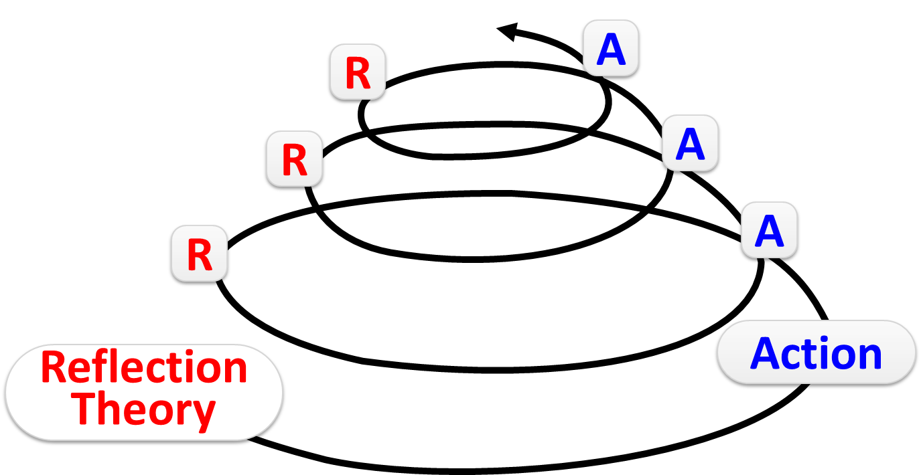
Easy in theory but most challenging to apply

Slide 9
Avoid extremes and temptations:
Smaller churches/orgs False Humility Scarcity mindset Passive Woe to me Inward looking Focused on tradition and history | Road Less Travelled Security and identity as Children of God. Assertive, confront ‘failures’ and ongoing learning. God-size vision and glory to God. Intentionally inter-dependent, helping others | Bigger churches/orgs. Pride False security Aggressive Independent Look at me Image, task and numbers driven

Slide 10
Kingdom-Focused
Good ambition and cooperation
Giving Generously
As a channel instead of the source
Being God’s Child
Security and Identity
→ courage and contentment
Jesus Redefining Success
‘Rich towards God’
NOT
Worldly Success

Slide 11
Redefining Success according to Jesus
7-week Challenge
Week | Topic
1 | Identify harmful definitions and blind spots
2 | Connecting with the real Jesus
3 | Being God's Children
4 | Being Kingdom-focused
5 | Giving Generously and Community
6 | Review and the Motivation
7 | Celebrate and Prayer
redefiningsuccess.com.au

Slide 12
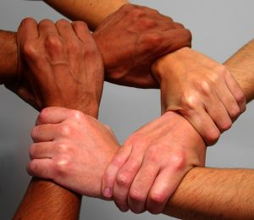
3. Redefining Success in Community
You cannot do it alone
Exchange isolation and competition for a
small group for mutual support and accountability

Slide 13
Join me in getting the message out
Free PDF of my book for your team
Use book for Small Groups
Preach from it
Sell on consignment and 50% sale to your church or project
Paperback from
redefiningsuccess.com.au
RRP $19
Easter special $15
Bulk discount
omar.djoeandy@sim.org.au

